Slide 1
Redux Saga Test
Carr Wang

Slide 2
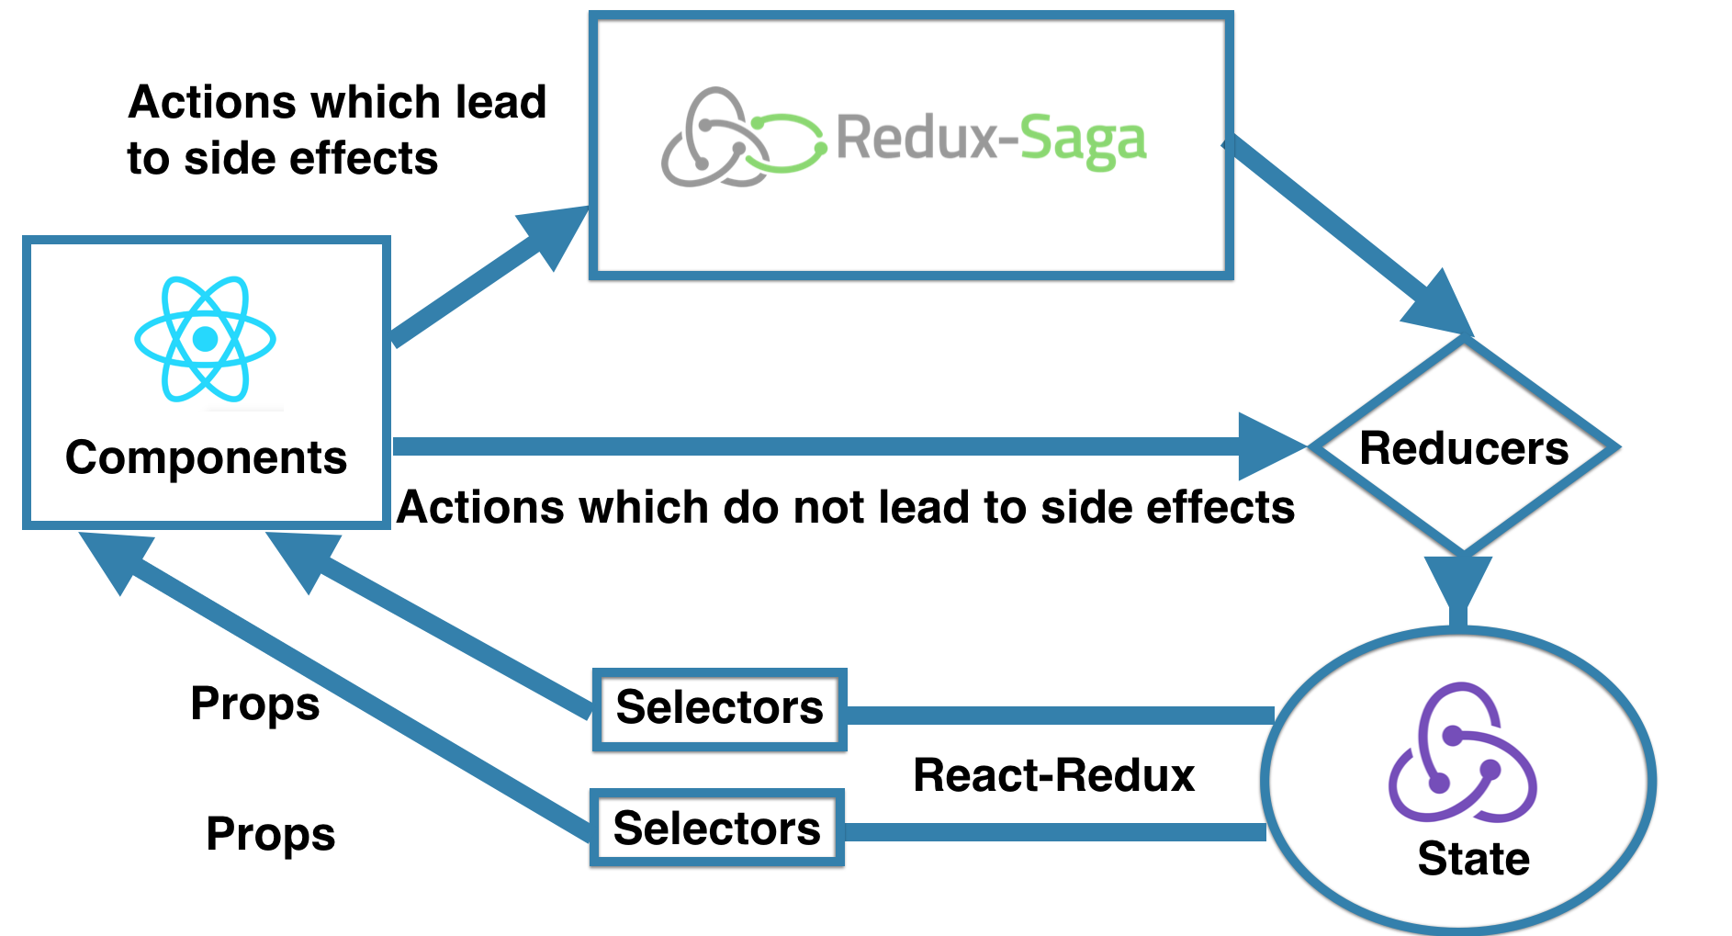
Redux Saga Recap
reference
Notes:
https://medium.com/practo-engineering/testing-redux-sagas-with-a-plan-e59124c5d139

Slide 3
Redux Saga Recap
Actions
: const fetchTodosSuccess = (payload) => ({ type: 'FETCH_TODOS_SUCCESS', payload })
Sagas
: function* fetchTodoSaga () { … }
: function* watchingFetchTodo () { … }
Effects
: const result = yield call(api.fetchTodos)
: yield put(fetchTodosFailure())
Helper Effects
: yield takeLatest('FETCH_TODOS', fetchTodoSaga)

Slide 4
Declarative Effects
An Effect is an object that contains some information to be interpreted by the middleware. You can view Effects like instructions to the middleware to perform some operation.
Saga
Middleware
{
CALL: {
fn: api.fetch,
args:[]
}
}
function* fetchTodoSaga (action) {
try {
const result = yield call(api.fetchTodos);
yield put(fetchTodosSuccess(result));
} catch (e) {
...
}
}
{
PUT: {
type: 'FETCH_TODOS_SUCCESS',
payload: result
}
}

Slide 5


Effects
Effects are plain JavaScript objects which contain instructions to be fulfilled by the middleware.
const result = yield api.fetchTodos();
const result = yield call(api.fetchTodos);
AJAX
{
CALL: {
fn: api.fetch,
args:[]
}
}
response
response
response
Saga
Middleware
AJAX
response

Slide 6
Redux Saga Test
Redux Saga Test Plan

Slide 7
Redux Saga Test - Unit Test
Use the testSaga functionen to test your saga yields specific types of effects in a particular order.
describe('Sagas Unit test', () => {
const expectedRspn = { foo: 'bar' };
it('should work', () => {
testSaga(
fetchTodoSaga,
{ payload: undefined },
).next().call(api.fetchTodos)
.next(expectedRspn)
.put(fetchTodosSuccess(expectedRspn))
.next().isDone();
});
});
function* fetchTodoSaga () {
...
const result = yield call(api.fetchTodos);
yield put(fetchTodosSuccess(result));
...
}
Passing the mocked response

Slide 8
Redux Saga Test
Expected
Actual
{
CALL: {
fn: api.fetch,
args:[]
}
}
{
CALL: {
fn: api.fetch,
args:[]
}
}
{
PUT: {
type: 'FETCH_TODOS_SUCCESS',
payload: result
}
}
{
PUT: {
type: 'FETCH_TODOS_SUCCESS',
payload: result
}
}

